Slide 1

Saab r-TWR - a centre of Towers enabling services for all airspace users
DATS Workshop on Digital Air Traffic Services: Workload and Safety Assessment
Niclas Gustavsson, VP Business Development, SDATS
Notes:
Instructions how to use the Saab Powerpoint template
This template have been created to deliver a consistent Saab message to all audiences.
It only uses Arial font, standard with Microsoft Office.
This Powerpoint template offers:
16:9 aspect ratio (widescreen size compatible with HD monitors)
Various title slides
Various chapter slides
Layout options including quote slides, slides for content and graph/data/picture/film
A variety of Saab colors
Consider the audience and environment when choosing slide variation.
For instance, dark backgrounds may work well for conference presentations, but are not ideal for corporate or printing purposes.
The template suggests font usage, type size for headlines and bullets, and layouts for charts and graphs.

Slide 2
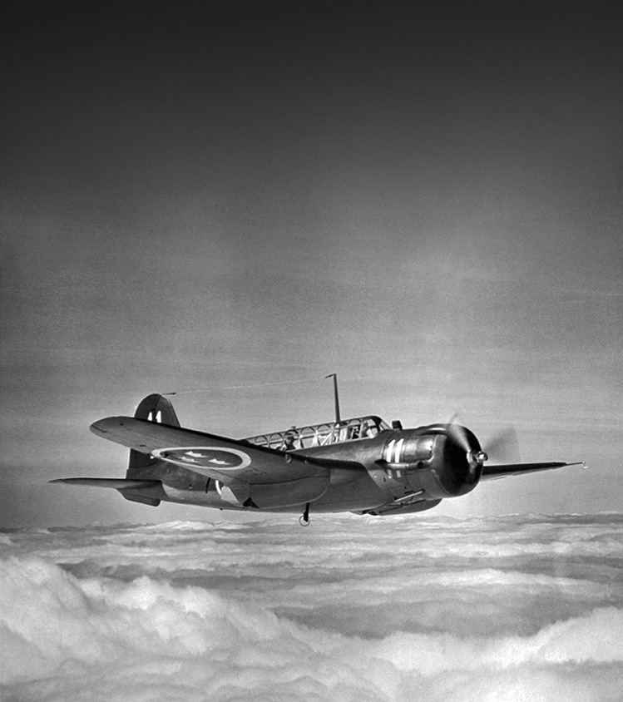

In 1937 we took off
A history from the 17th century through Alfred Nobel (Bofors) and the shipyard in Karlskrona (Kockums)
In 1937, Saab was founded to protect Sweden’s borders and its people
Born smart – as a small country, we were forced to arm ourselves with good and cost-effective equipment
On our journey we created Sweden’s computer, missile and space industries
Read more about our history at history.saab.com
Notes:
HISTORY
When Saab was founded in 1937 our primary aim was to provide military aircraft for Sweden. Saab became an important part of the industry that sprang up to guarantee neutrality, independence and self-sufficiency – and as a cradle for Swedish engineering. Intelligent and cost-effective solutions were required from the start. In short: Saab was born smart.
Since then, Saab have progressed through generations of military jet aircraft, introducing world-leading technology every step of the way. We have been building on our military heritage and Swedish pragmatism, and we have not stood still…
Our extraordinary technological challenges throughout the years have driven and developed Saab into a broad-based Swedish innovation powerhouse. On our journey we have helped create Sweden’s computer, missile and space industries – and we used to produce cars, trucks and buses too.
Worth mentioning: Parts of our history with Bofors and Kockums go back to the 17th century through the famous scientist Alfred Nobel (Bofors) and the shipyard in Karlskrona (later Kockums). A few other important dates: 1941, First B17 delivered. 1948, First order of Carl-Gustav. 1978, First Giraffe radars delivered. 1993, First Gripen delivered. 2006, First series order of Erieye. 2015, First order of A26.

Slide 3
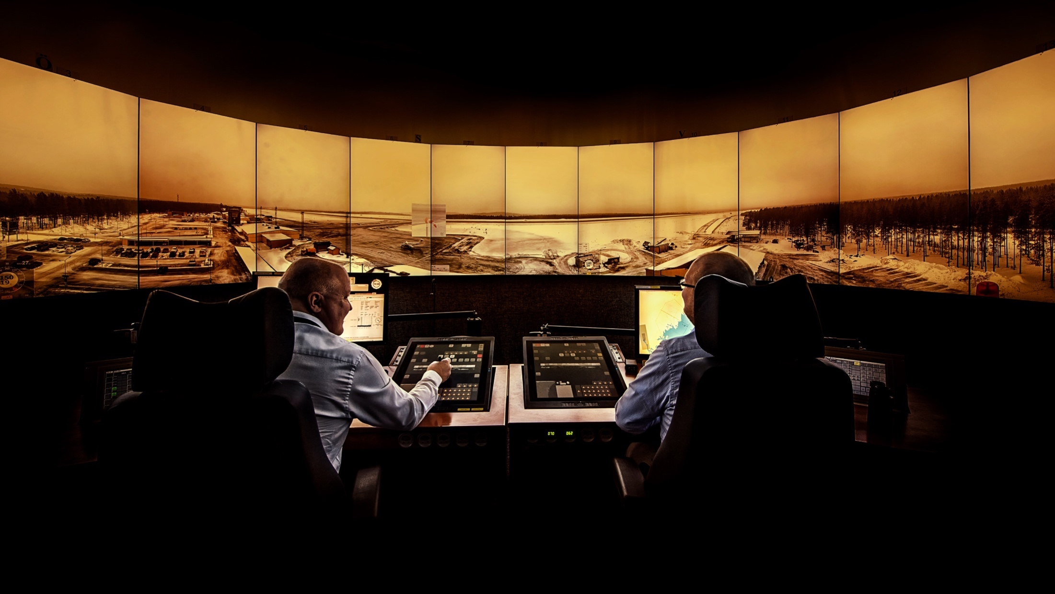





SAAB AND LFV
A WIN-WIN SOLUTION
  Saab and LFV (the Swedish Air navigation Service Provider)
  have established Saab Digital Air Traffic Solutions AB
  The company markets, sells, develops and operates products
  and services for digital air traffic control
  The company provides innovative customised remote air traffic
  control by combining unique operational and technical excellence
  to benefit our customers and society
  A digital ANS provider for the future

Slide 4

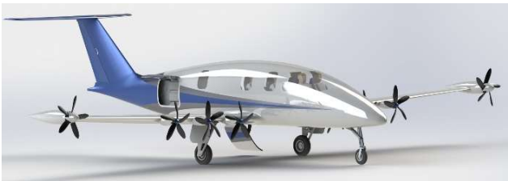
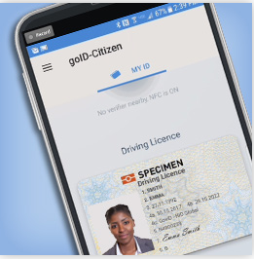


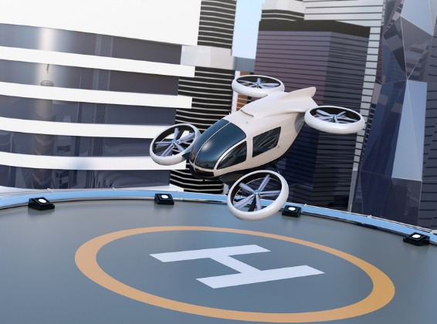


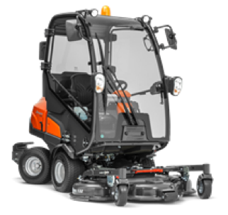
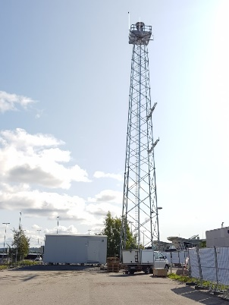

There is a new ATM Landscape taking shape…

Slide 5
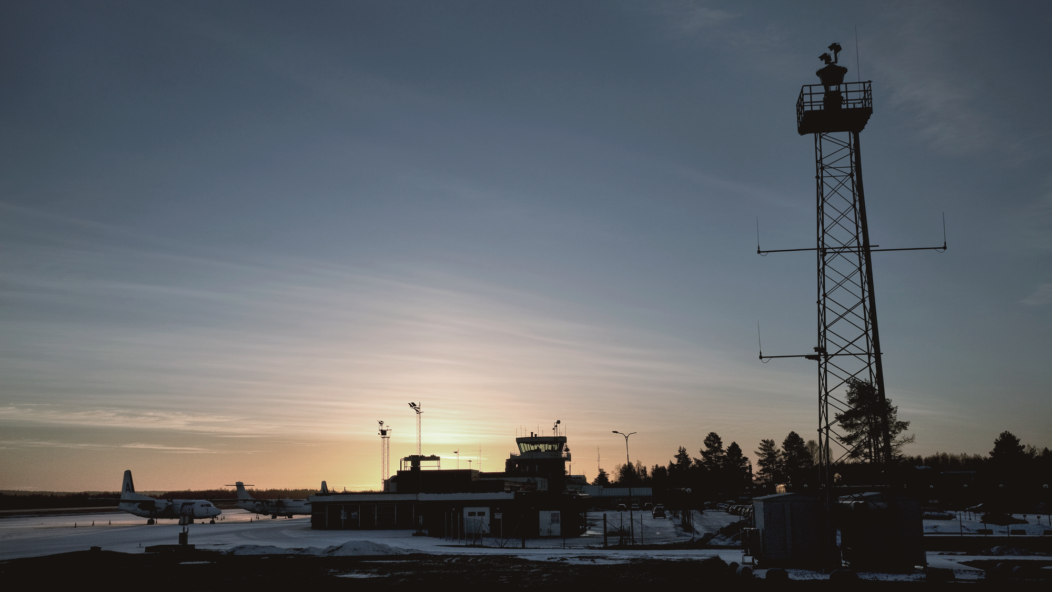
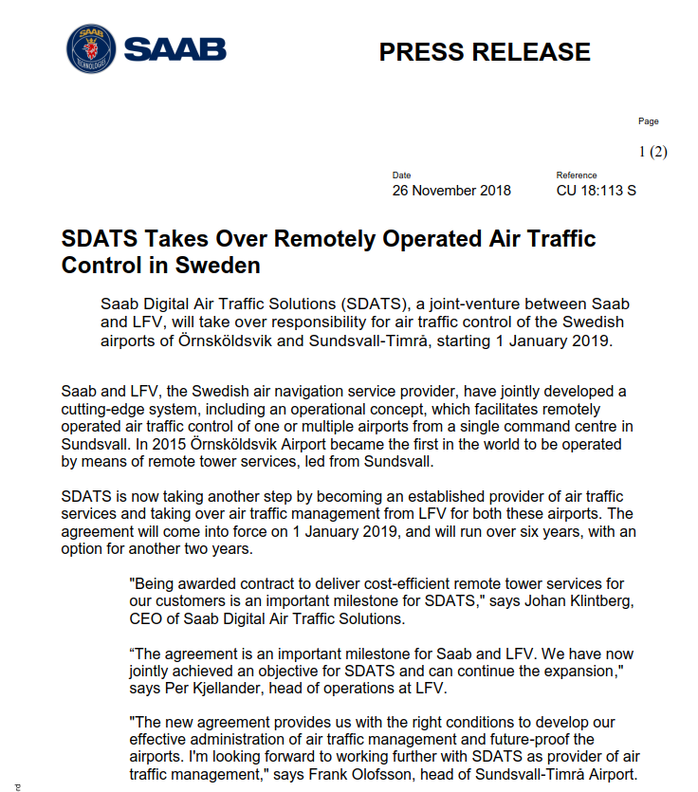
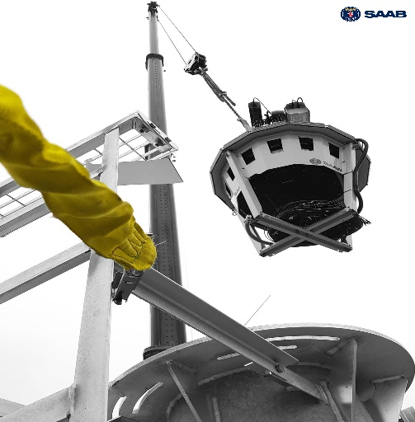
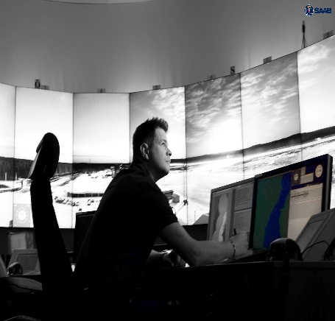
A digital ANS Provider…and supplier
By

Slide 6


Ops + Tech = Full service offer
Saab Digital Air Traffic Solutions
…driving the global digitalization of Tower services
Technical Systems and solutions
Operational services
Fast tracking fielding of
Saab r-twr systems
Updates based on operational
And system experience
ADD-ON Services

Slide 7
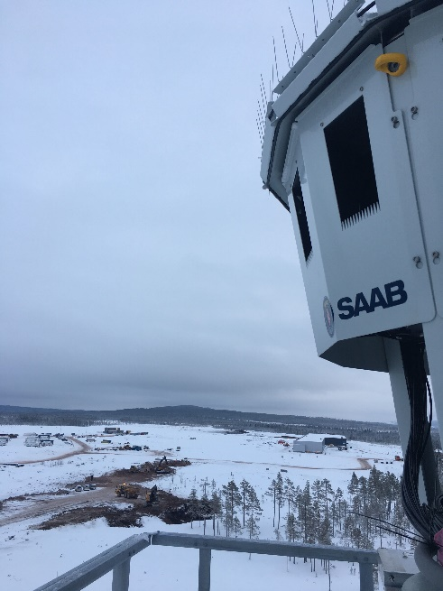
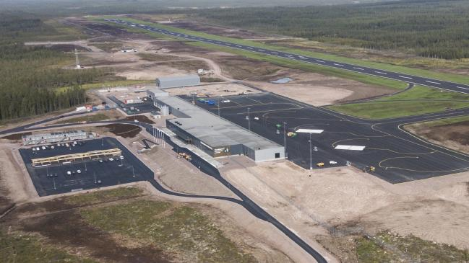
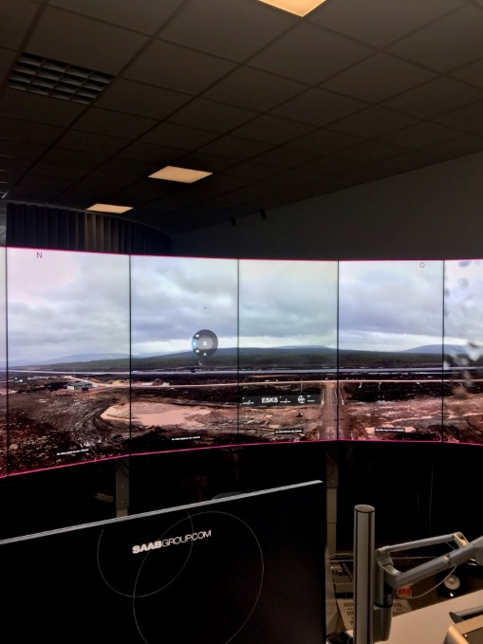
Scandinavian Mountains Airport

Slide 8
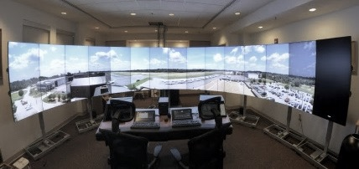
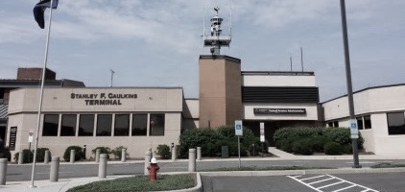
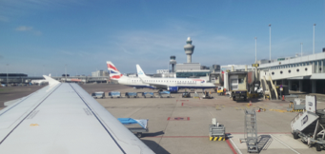
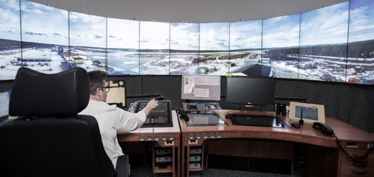




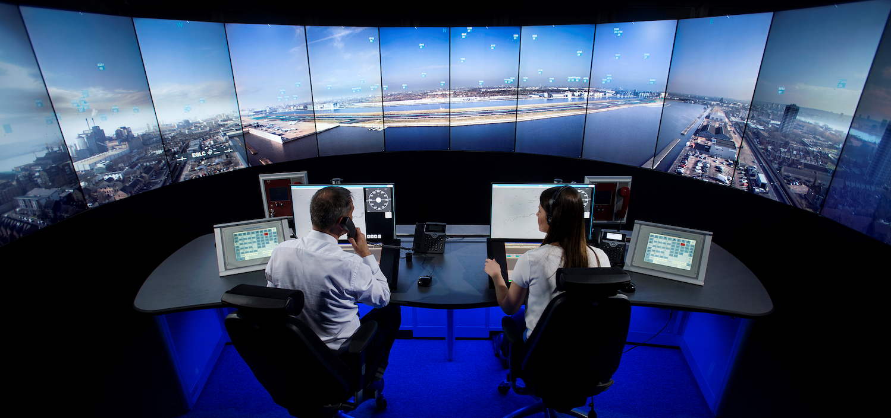
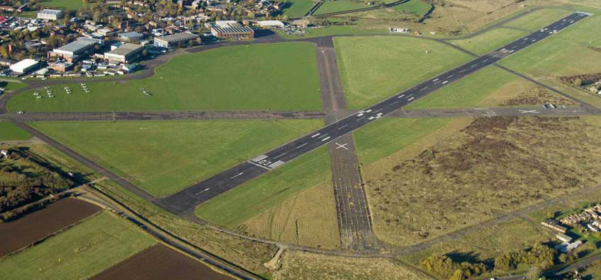
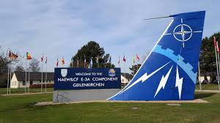
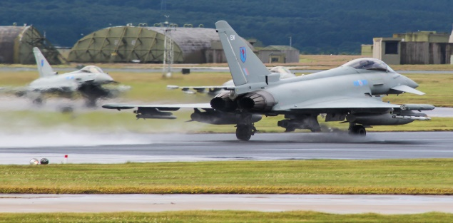

GLOBAL FOOTPRINT
SOLUTIONS INSTALLED AROUND THE WORLD
IN OPERATION
Evalution
IN OPERATION
Go- Live
Q4 2021
  IRELAND
  Cork and Shannon
  USA
  Leesburg Airport
  THE NETHERLANDS
  Schiphol,Centralised base
  SWEDEN
  RTC Sundsvall Örnsköldsvik, Sundsvall, Linköping, SMA
Go- Live
Dec 2020
Go- Live
Q1 2021
IN OPERATION
IN OPERATION
  UK
  London City Airport
  UK
  Cranfield Airport
  SWEDEN
  RTC Stockholm + 4 airports
  SWEDEN
  Scandinavian Mountain Airport
Go- Live
Q1 2021
  GERMANY
  NATO Base, Geilenkirchen
  UK
  RAF Base, Lossiemouth
  UK
  Royal NAvy, Culdrose/ Predannack

Slide 9


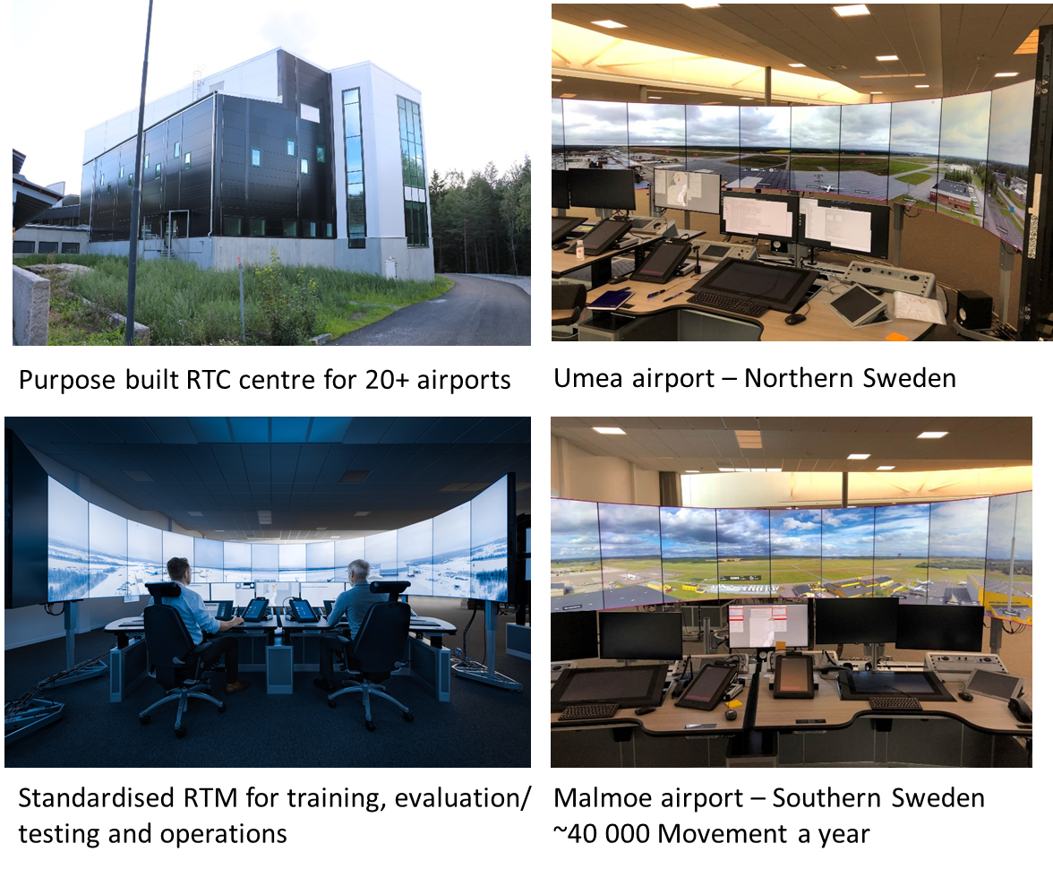
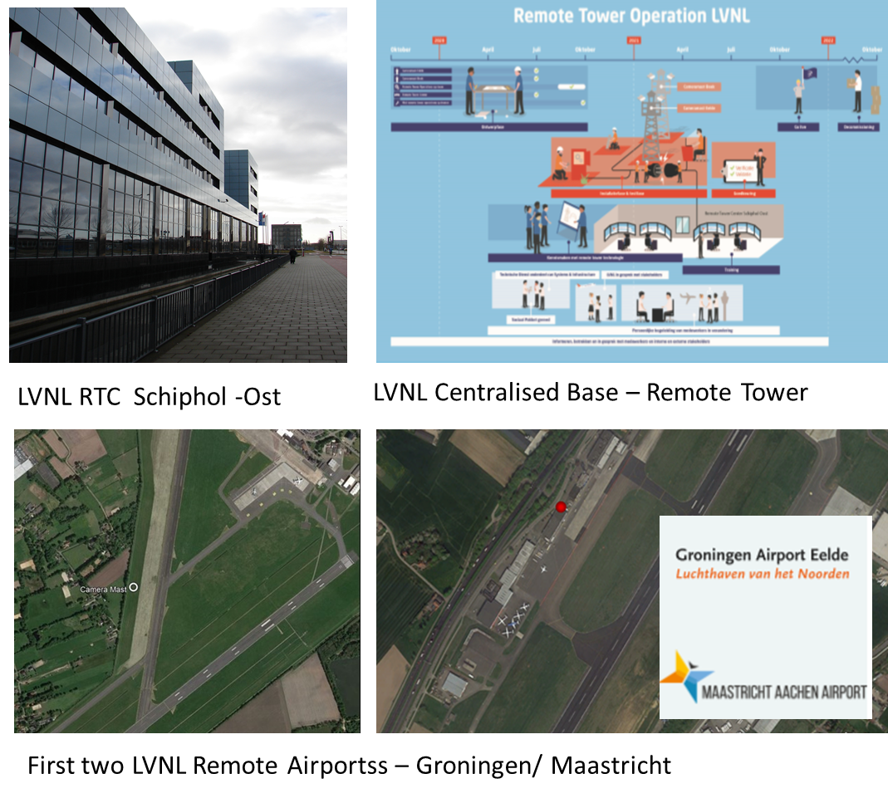
Two Saab r-TWR 2.0 centres in the making

Slide 10
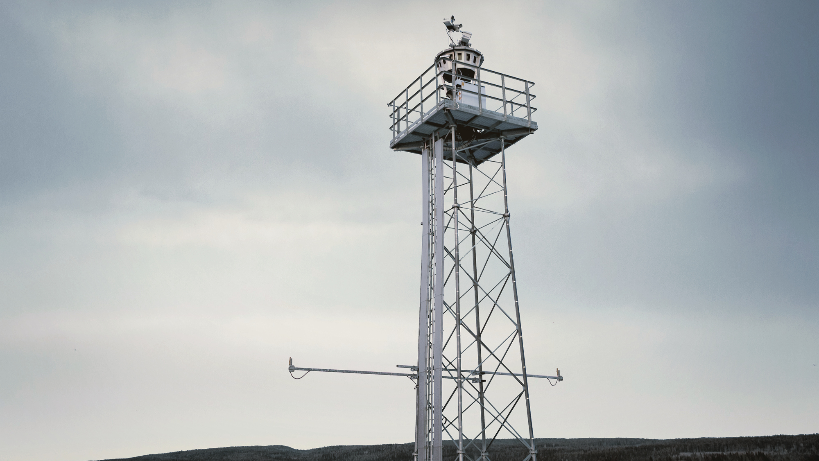
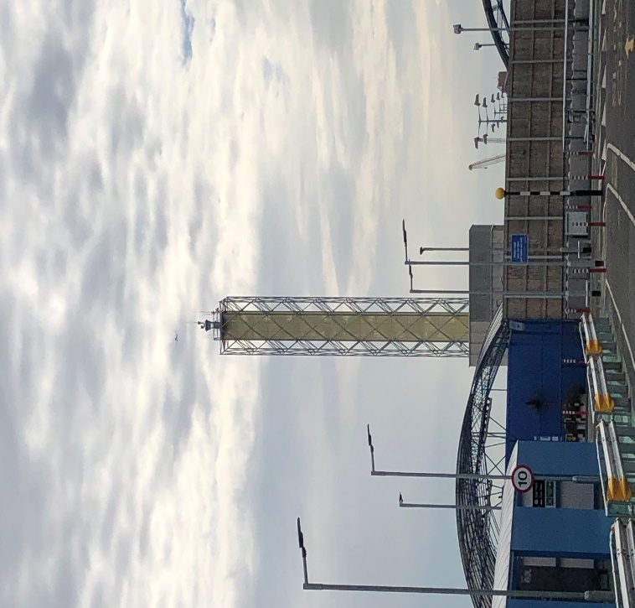
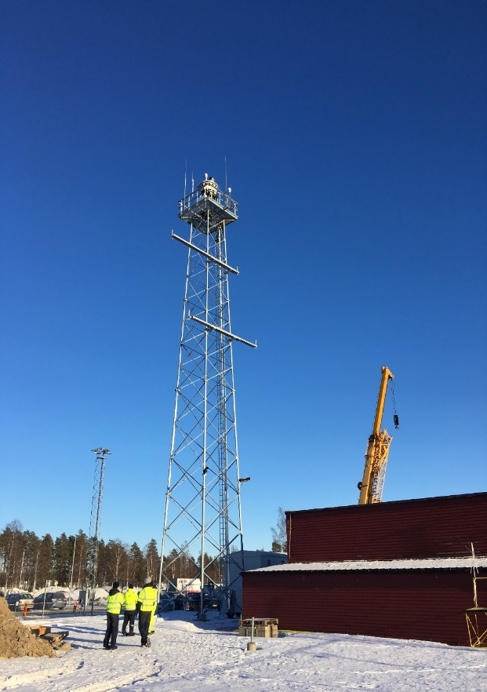
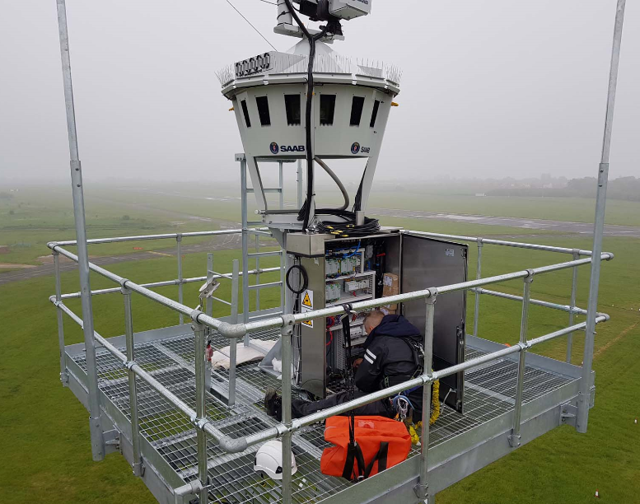
A new Digital Skyline

Slide 11
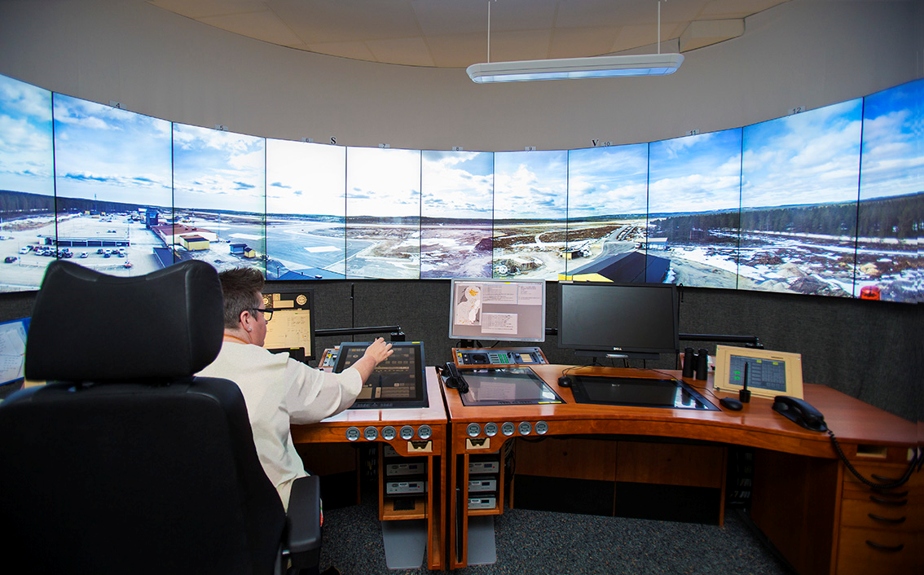
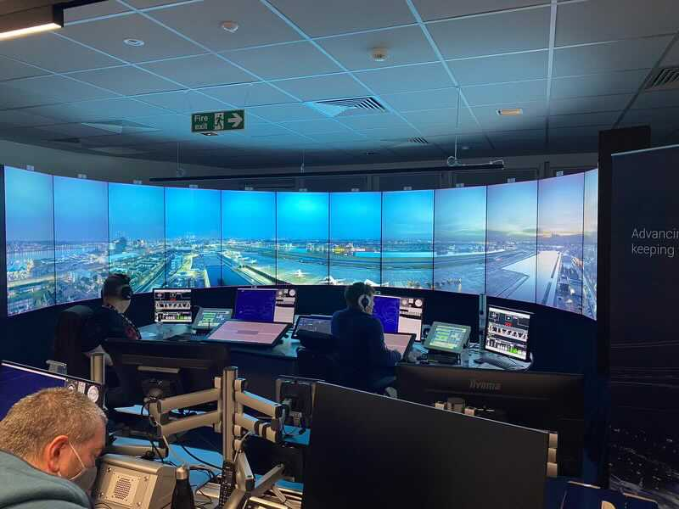
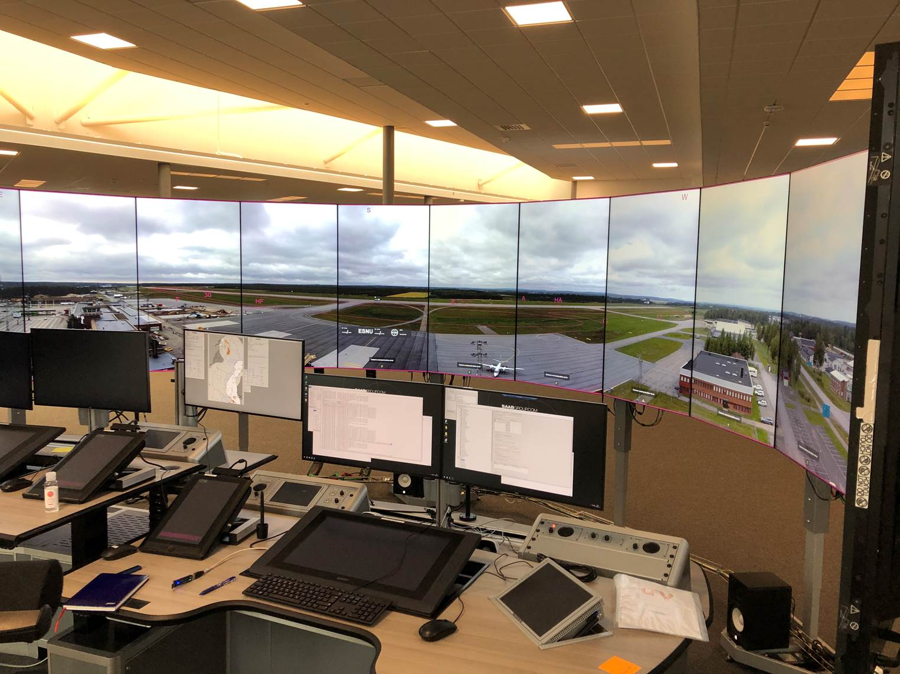
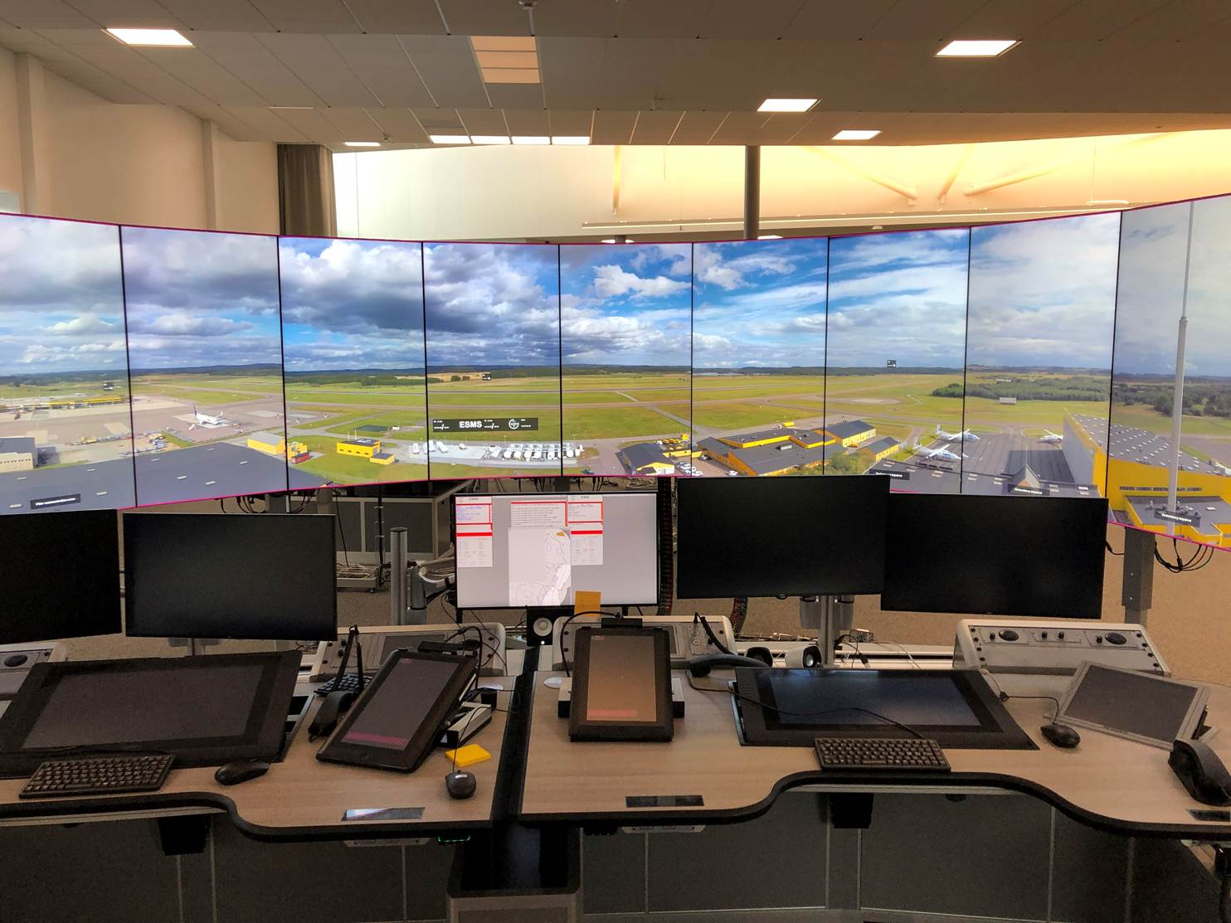
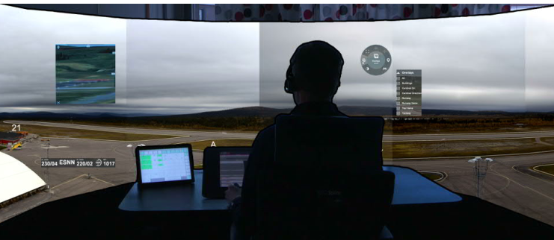
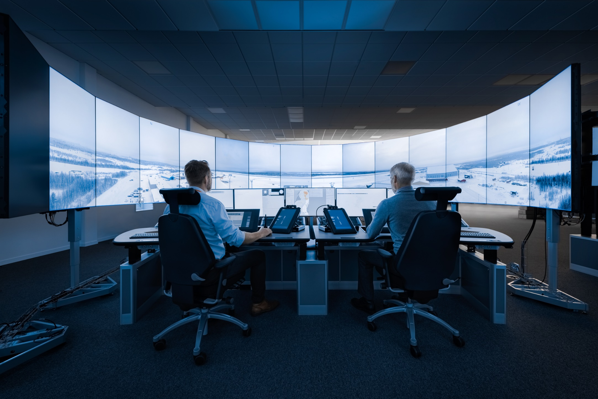
A new Digital Working environment

Slide 12
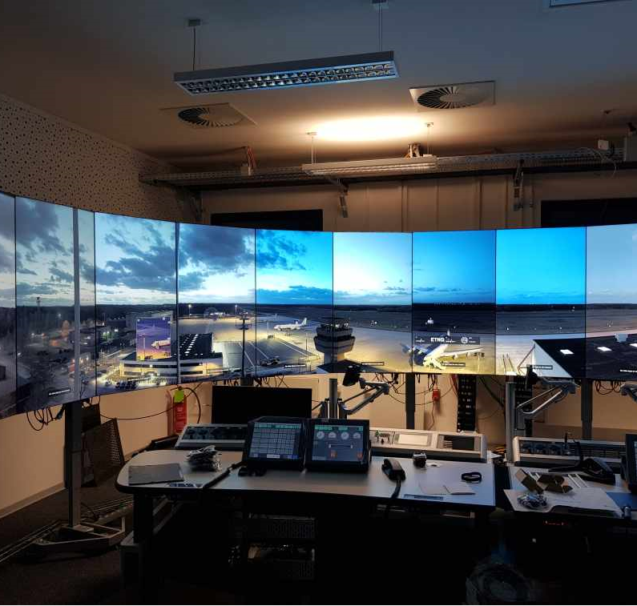
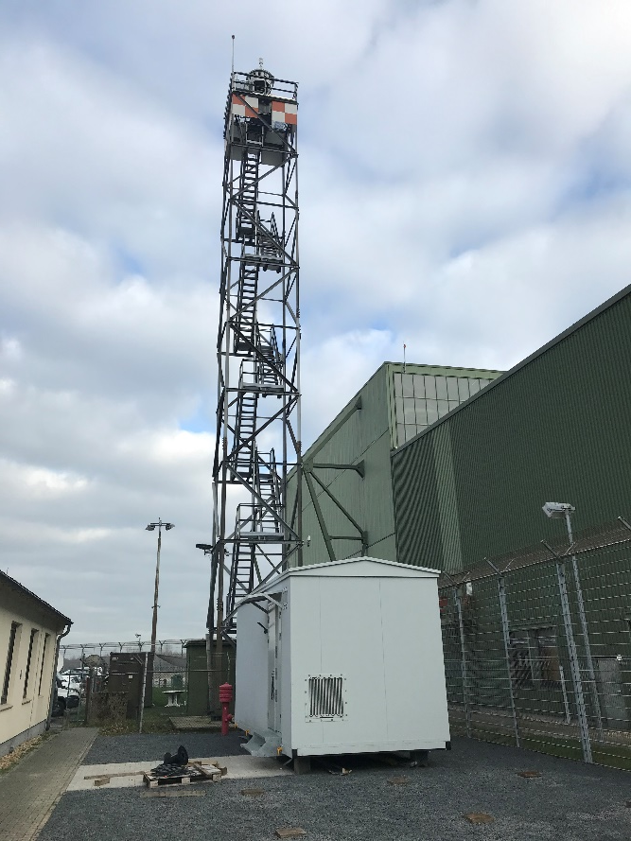
Geilenkirchen NATO base
First Saab r-TWR installation in Germany
– public tender award
Very good collaboration with Luftwaffe and NATO
Operations planned to start in March -2021
Support to German Mil. Regulatory approval
Basis for further NATO use of Saab r-TWR

Slide 13
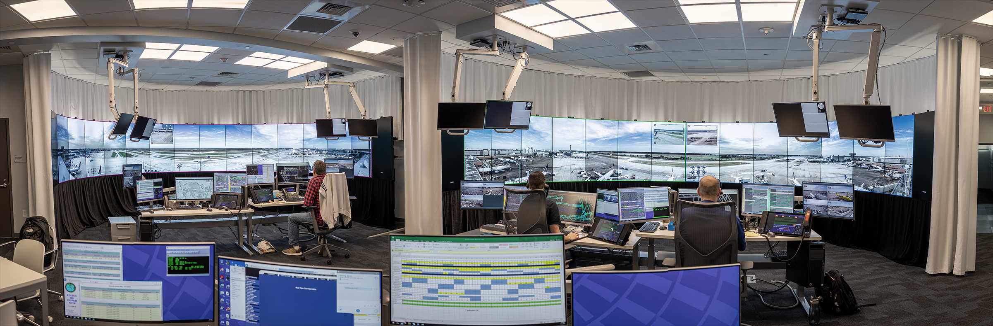
Ramp tower – airport control – Large Airports

Slide 14
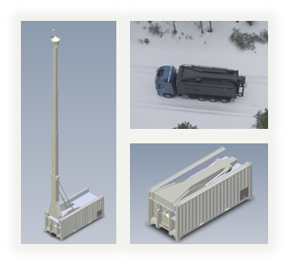
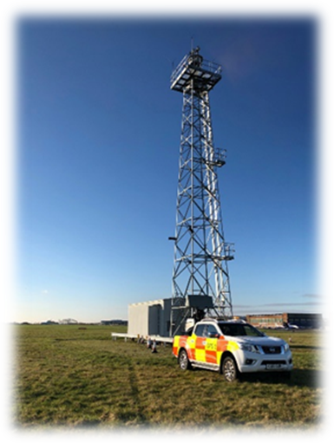
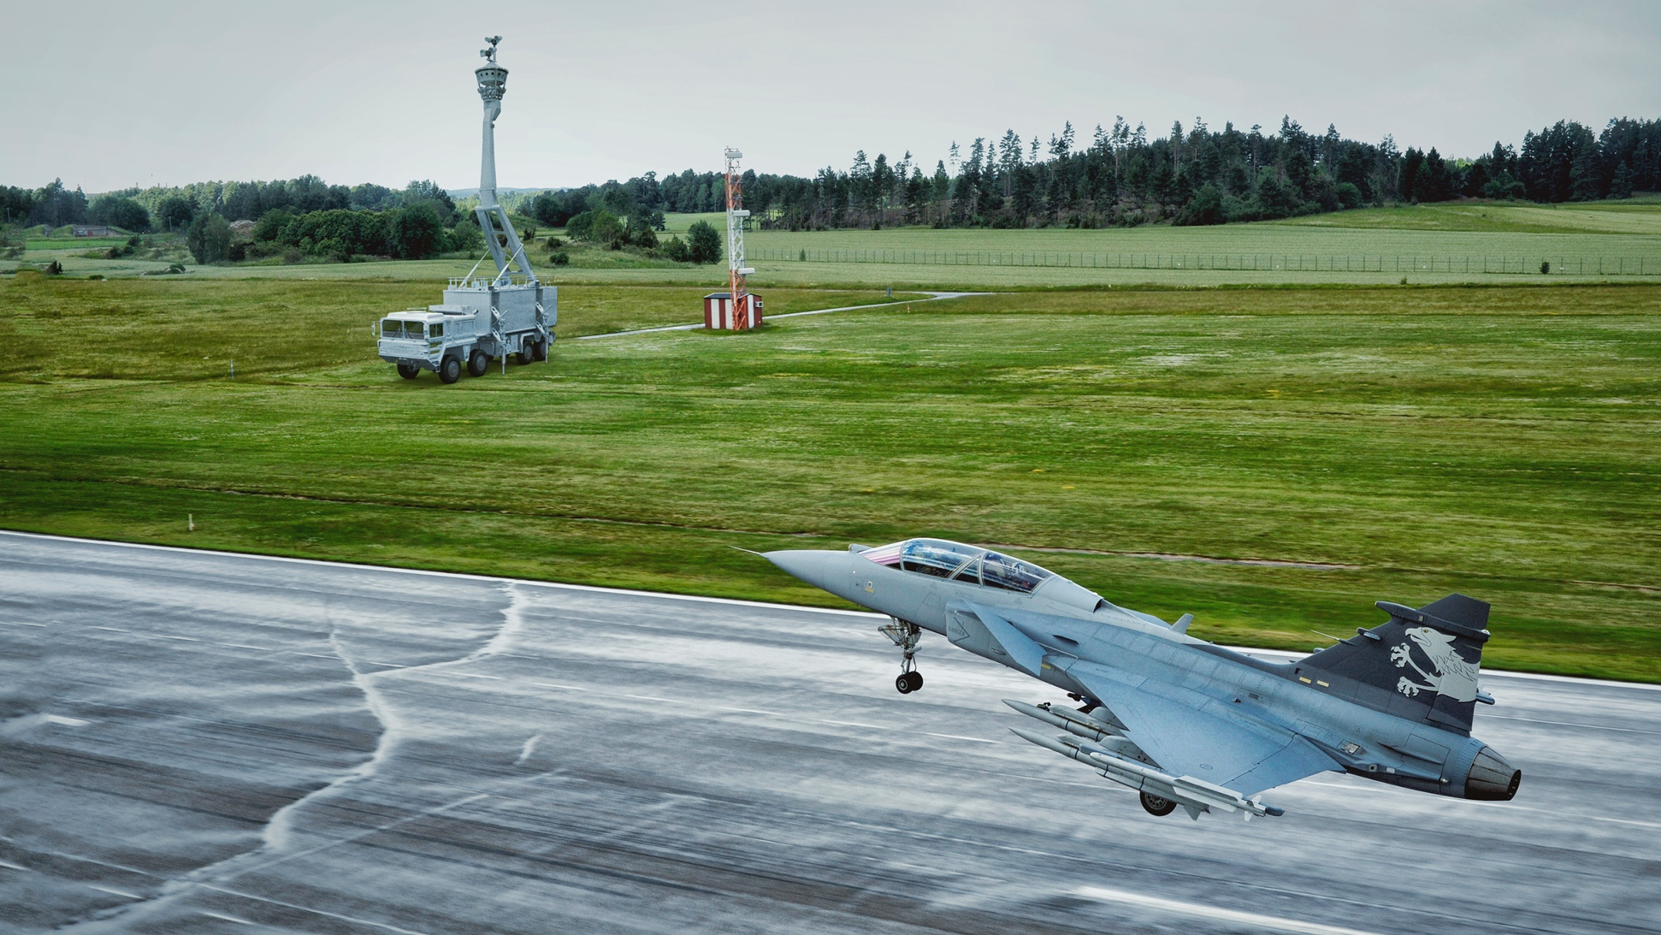
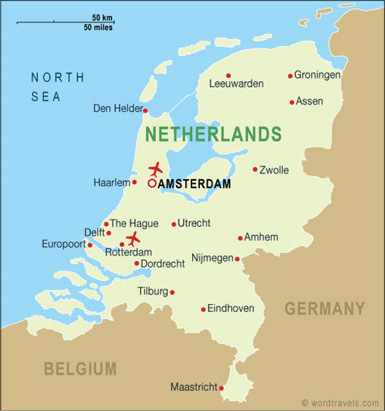
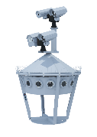
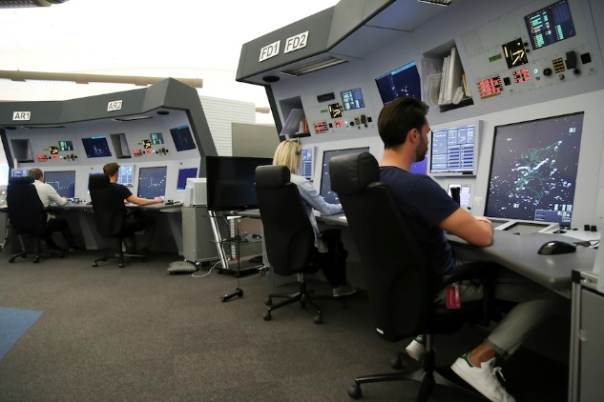
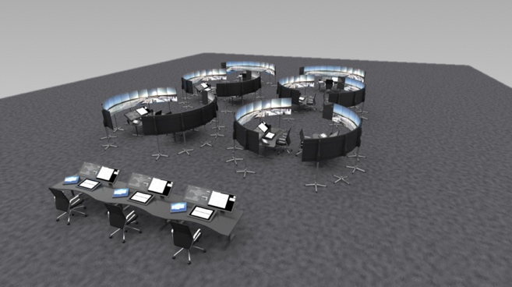
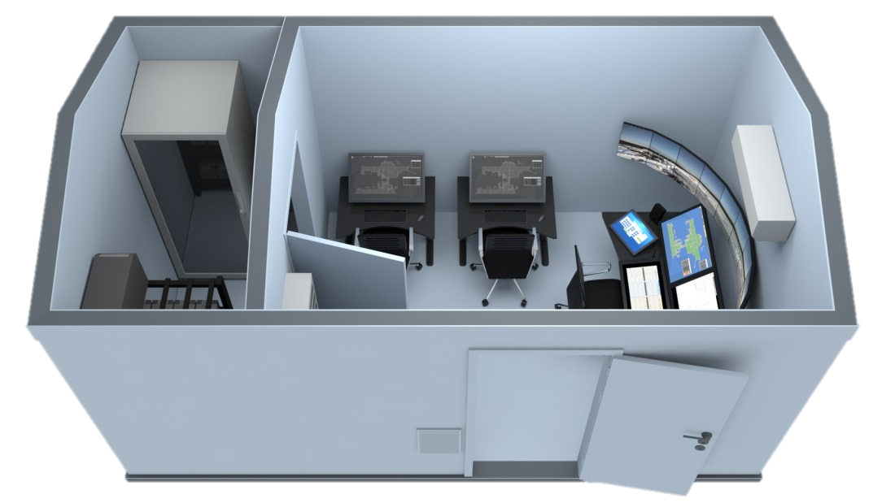
Mil r-TWR - a networked Air Traffic Control concept
Notes:
The new digital technology might have many applications. Just getting it into place will open up for new ideas.

Slide 15
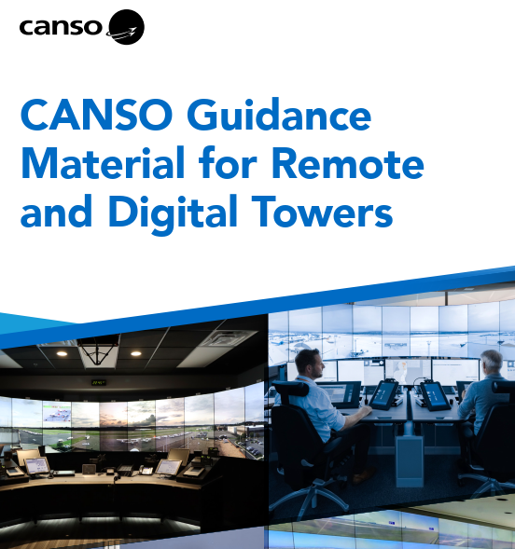
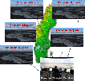
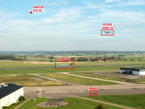
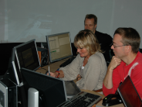
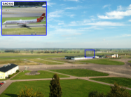
























´Change takes time and persistance…..
r-TWR proof of concept project start
ART project start
Shadow mode validations
at Sturup
ART validations
at Sturup
The second
r-TWR symposium
SESAR validation 2 single
Delivery of
SESAR r-TWR
prototype
Værøy-Bodø
Delivery of
r-TWR test system to Airservices
SESAR validation Contingency Landvetter
The third
r-TWR symposium
Approved
for operational use
IAA Contract
2nd airport in operation in Sweden
London City Airport Contract
Cranfield (UK) Contract
2006
2007
2008
2009
2010
2011
2012
2013
2014
2015
2016
2017
2018
r-TWR installed at Ängelholm airport
ATC Global 2009 & r-TWR rollout
Start of
SESAR r-TWR
projects
SESAR validation 1 single
Delivery of 1st operational
r-TWR system
SESAR validation
AFIS
Værøy-Bodø
Start of
operational
certification
in Sweden
Delivery to Røst
SESAR Multiple Simulation/ Validation
Contract
remote
RWY
Schiphol
Full operations 21st of April
Leesburg Virginia validations
Amendments to Annex 11 and Doc 4444
Notes:
Slide 7: Max 1 minutes
Total 5 minutes

Slide 16





Saab r-TWR product family road map
Functionality
Off-Shore – special adaptations
Business continuity
Certification
AFIS – light versions
Large Complex Airports
Software
Digital TWR
Single RWY
Building on a Swedish, EU, US, UK
Certifications – standard product
Hardware
Military
adaptations
Airport
Ramp towers
Maintanabiity
Mobile/ tactical deployement
SMART Airport integration
R&D

Slide 17

Saab r-TWR, a product not a project !
Second generation of Saab r-TWR system based on
operational experience
  Enhanced weather environmental protection
  Simplified and reduced maintenance costs – lower LCC
  Enhanced HMI for ATCO’s – interface on the panorama screens
  Safety features
Integrated Simulation and Training concept
Improved production and ”transition into service” processes
New production and testing facilities
Qualified experts for all phases of the implementation

Slide 18


Saab r-TWR – strategic road map supporting operational evolution
R.TWR 3.0
R.TWR 4.0
R.TWR 2.0
Flexible / scalable HMI
Reduced HW units/ footprint
Improved maintenance procedures
Improved IT-security
Centre tools
VCS integration
R.TWR 1.0
Drone
ATM/ UTM/ UAM integration
Drone detection
AI adoption
New sensor
360 degree to /220 arc
Camera solution
EFS, RDP, FDP integration
Alarms
Basic functions
By
New Camera chain
New HMI
Centre architecture
Tracking / MAC/ C-APP
Simulator
Radar labels
Expanded operational concept →
Same basic operational concept →
Offered to market →
Offered to market →
Offered to market
Offered to market
2011
2015
2020
2025
2028 +
RTC Sundsvall
PILOT airports
RTC Stockholm/
Schiphol
Centre operations
Other centers
and a variety of
civ/ Mil airports and users

Slide 19







Digital possibilities - innovating the future
Local weather
Visual and radar tracking
Outline runway, taxiway etc.
Tracking birds, and drones...
Gap filler cameras
AI enhancements
IR cameras
Notes:
Since all surveillance data is digitalized, we can add a lot of overlayed information to improve the Situational Awareness for the controller. This can´t even be compared to the traditional working method based on looking out of the windows.
Many safety nets have now also been added to help the controller to detecting and monitor anomalities.
With IR, image amplification and gapfiller cameras, the controller can see things he didn´t see before.
One example is at Sundsvall, when the visual tracker detected something close to the runway in the darkness in the evening. With the IR the ATCO saw a big moose standing just beside the runway. They sent out a hunter who shot the moose. Everyone excepet the moose was happy , but if it hadn´t been detected, it could have ended up in a real disaster.

Slide 20

Multiple Airport Control - Ready to go

Slide 21

We keep on researching….
Information
Display
Airport C
Air Surveillance
Display
Airport B
Airport A

Slide 22







Some key development areas
Compact Remote Tower Module
Saab TACTICALL VCS integration
Integrated Simulation & Training
Centre efficiency tools - capacity planning – ATCO briefing tools
Single Camera Housing
Large Complex Airport integration
UTM/ATM integration
C-UAS/ Sensor integration G1X
AI/ Video Analytics
r-TWR deployable

Slide 23


A centre of towers – flexible and resilient
Reserve/ Spare
Integrated training
Same systems and CWP
for different airports
Flexbility to open an close
Fully role-based setup
Up 24 airports in a centre
Integrated training
Multiple Airport Control
Cross border
Step wise introduction of
new support tools e.g. AI
Prepared for new services
Fostering a company culture
for the future
Joint supervision
Airport / CDM
UTM / UAM
Cyber Security
Regional Airports
Large airport contingency

Slide 24





r-TWR project, T0+14 months
Standard r-TWR 2.0 Centre/ RTM
( prepared for up to 20 airports)
OPTIONAL
Integrated Simulation & Training
Installation & Comissioning
Digital Tower Service by 2023 if ordered
Standard r-TWR 2.0 Airport system
Operational & regulatory support

Slide 25
DIGITAL TOWERS
MORE THAN A TECHNICAL SOLUTION
BUSINESS
CASE
TECHNICAL SOLUTION
OPERATIONAL INTEGRATION
CERTIFICATION
OPERATIONAL CONCEPT & LOCAL CONDITIONS

Slide 26
Digital Tower Market impact from COVID
No. Of Airports
Digital Towers - Digitalisation
Traditional Towers
2030
2040
Time
2020
Notes:
When global standards will come into play fully in 2020-21( ICAO) there is very limited reasons NOT to choose a digital solution in front of building a new tower or renovating it! Airports and ANSPs will spend money digital tools rather than concrete and steel!

Slide 27

Thanks for listening !
Niclas Gustavsson
Vice President
Business Development
Niclas.Gustavsson@saabgroup.com
+46 734 180714
Saab Digital Air Traffic Solutions

